Slide 1



LOOKER TRAINING FOR BEGINNERS
By Devarajan Palaniappan (DATA POLE)
Session 1

Slide 2
Looker Overview Looker Architecture Features of Looker Looker Connection Looker Key Areas Types of Modes Basics Views of LookML
Table of Contents

Slide 3
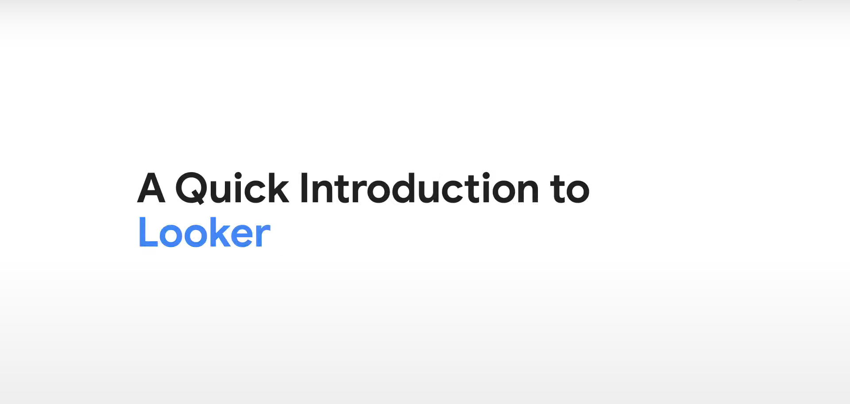

Slide 4
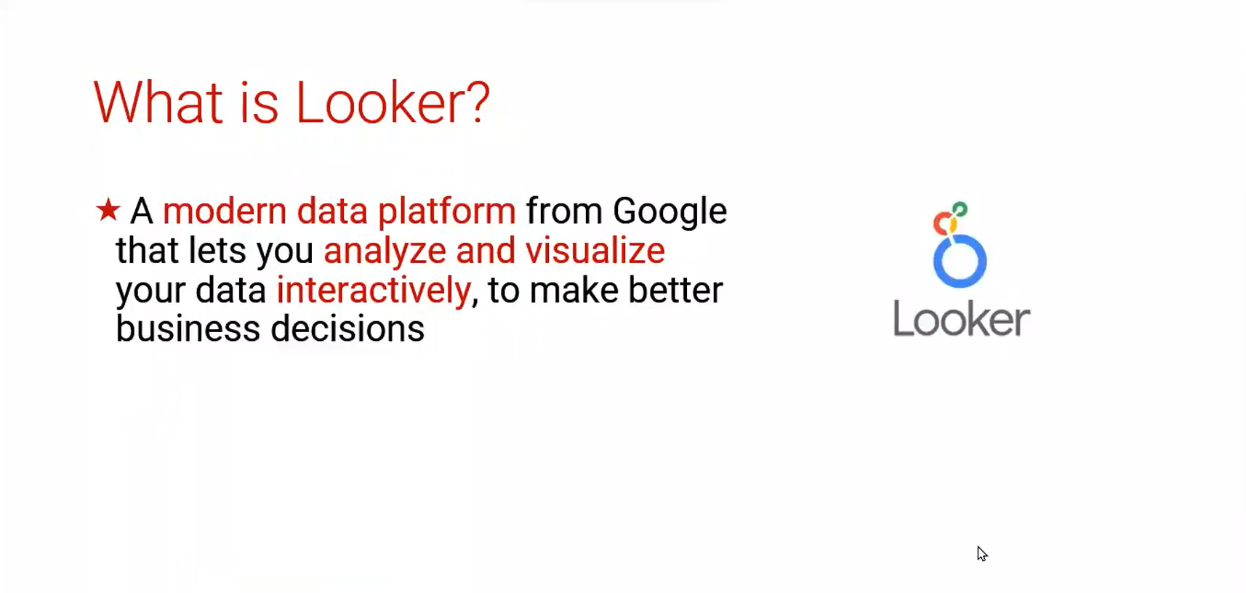

Slide 5
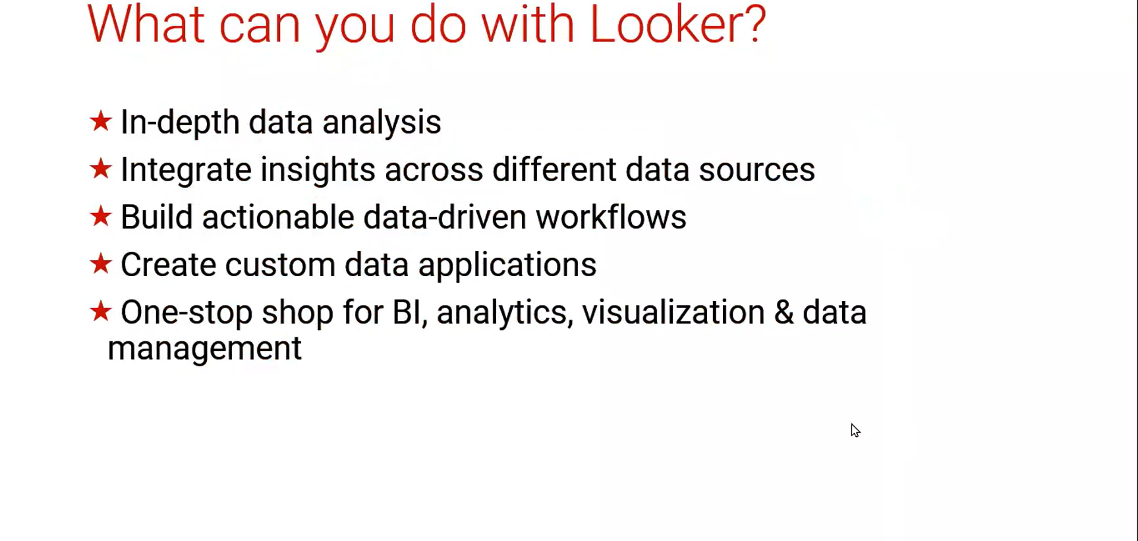

Slide 6
How is Looker different?
Looker can connect to number of data sources but one of the most powerful features is its trusted data model.
It has its own proprietary modeling language called LookML, which is defined as a better way to write SQL and define
Looker provides extensive visualization abilities with real-time analysis. Users can also create custom visualizations.
Looker's API integrates data with many applications such as Google Docs, Excel and a lot of third-party applications.
Looker Blocks feature streamlines integration by offering pre-built code that can be embedded into no of third-party apps.
LookML is the language used to describe dimensions, calculations, aggregations etc. This is what makes the tool unique and powerful
Looker Provides Version control advantage available on Git hub.
Looker has a strong stupport team. The response from them is also very quick
Looker helps to create custom data models by End users.
Fully Cloud-based platform

Slide 7
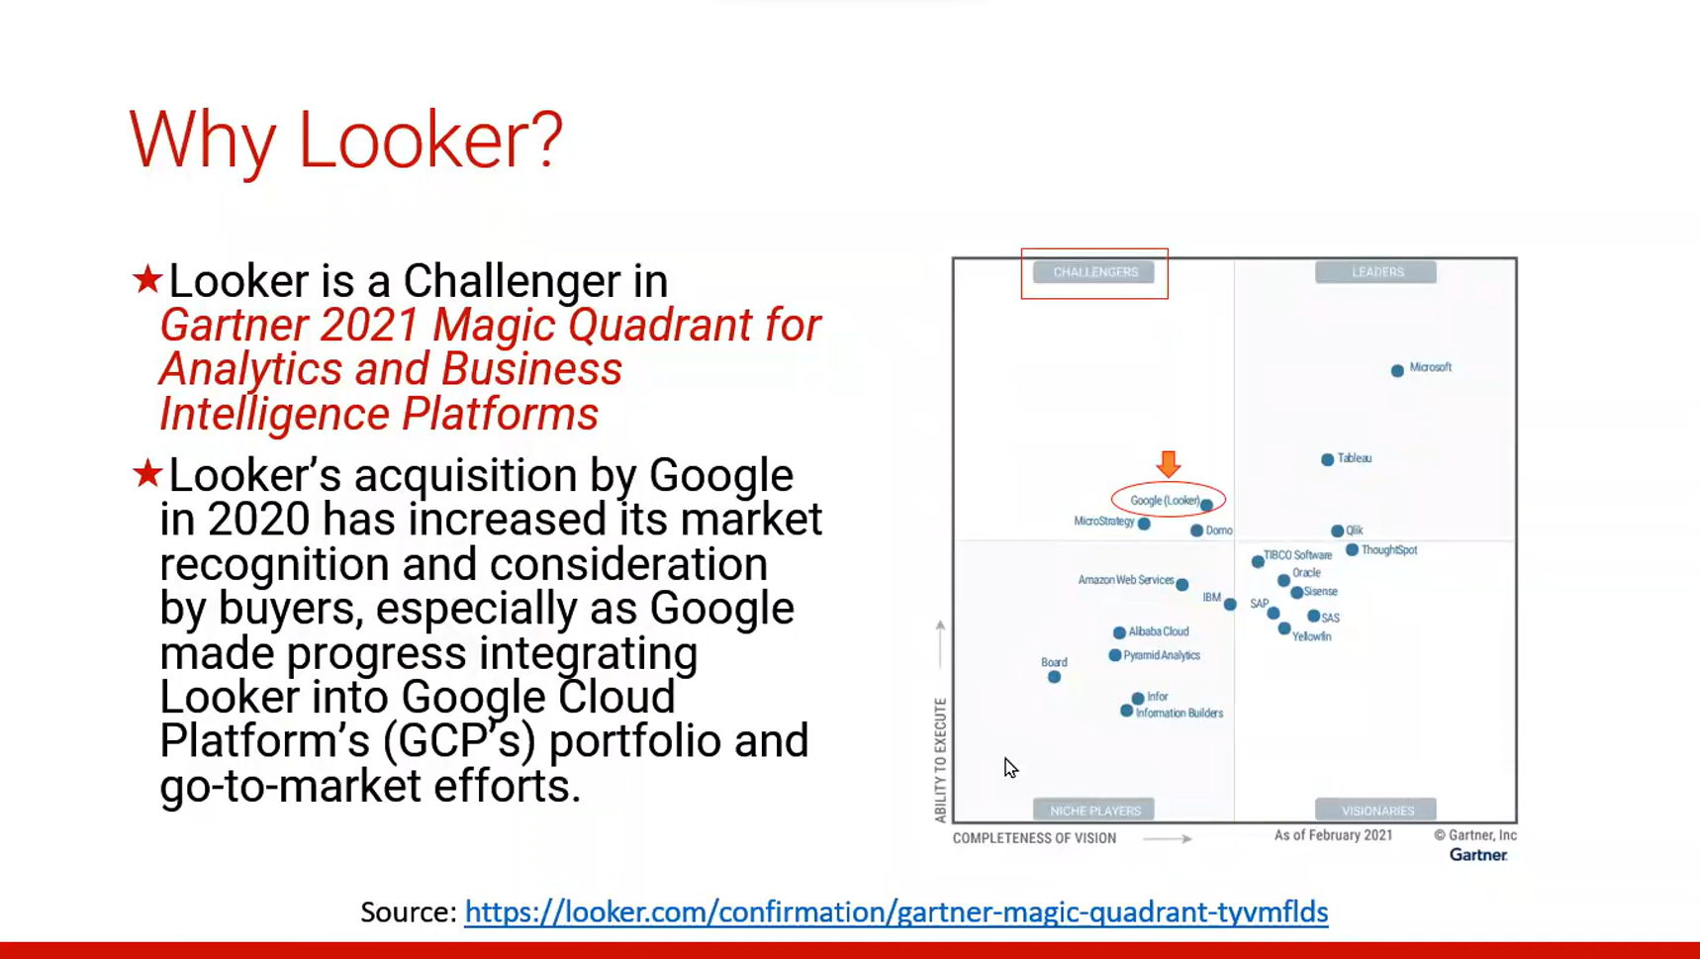
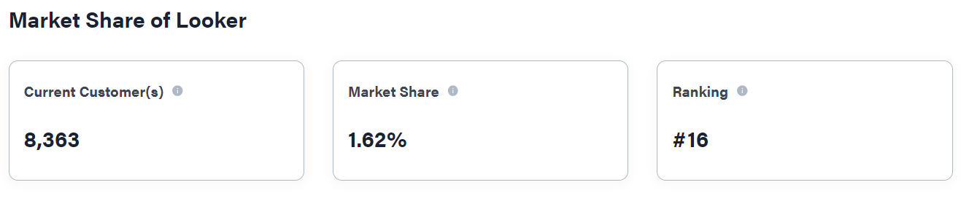

Slide 8
Looker BI tool from Google cloud platform(GCP)
It will support cloud applications (Databases – BIG Query, Snowflake)
Looker is completely cloud Access (No software required for Access)
Looker support more than 60+ Databases
Looker support Automation
Looker support GIT version control system
Looker support Mobile apps
Looker supports Machine learning
Default reporting tool for Google is Looker
Looker source language is LookML
LookML backend language is SQL
No data limitation
Forecast feature to explore queries to help users predict and monitor specific data points
FEATURES OF LOOKER BI :

Slide 9
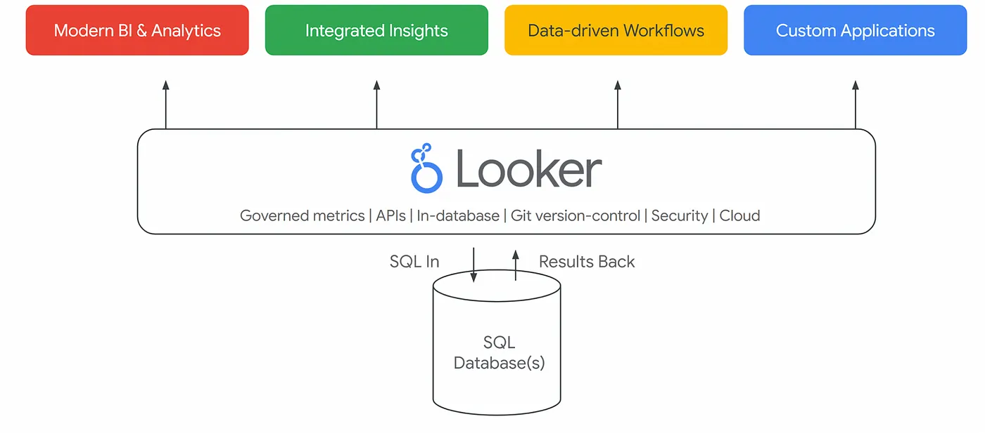
Looker Data Architecture :

Slide 10
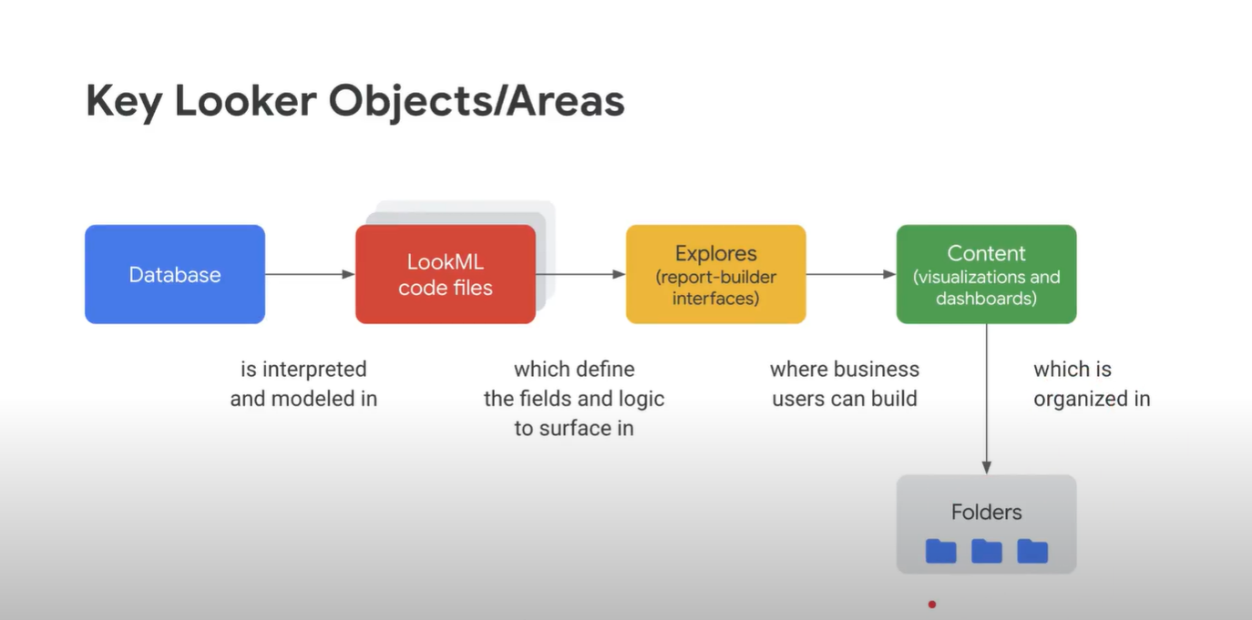

Slide 11

How do you set up a Looker connection?
In Looker, go to the Admin panel's Connection page. If you are in a trial, typically you won't have any connections on that page. Click Add Connection to set up the connection. Fill out the connection details.
We can use this link to know about Looker connection setup :
https://www.googlecloudcommunity.com/gc/Administering-Looker/How-to-create-a-BigQuery-connection-in-Looker/m-p/583179
https://cloud.google.com/looker/docs/connecting-to-your-db

Slide 12
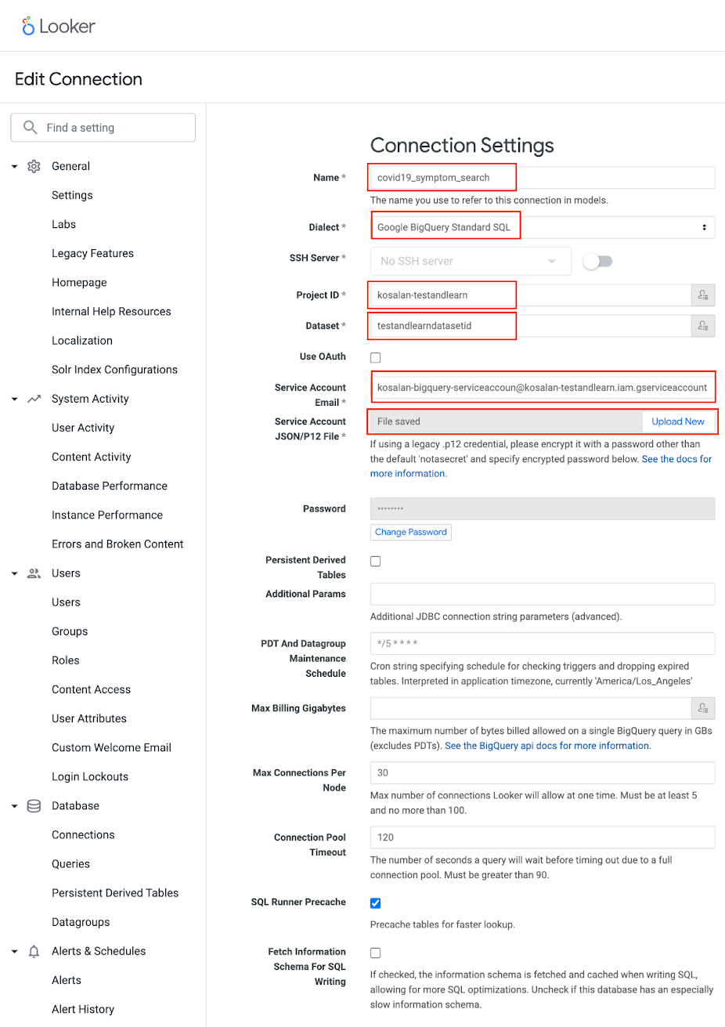
How to create a BigQuery connection in Looker?
We can use this link to know about Looker connection setup :
https://www.googlecloudcommunity.com/gc/Administering-Looker/How-to-create-a-BigQuery-connection-in-Looker/m-p/583179

Slide 13
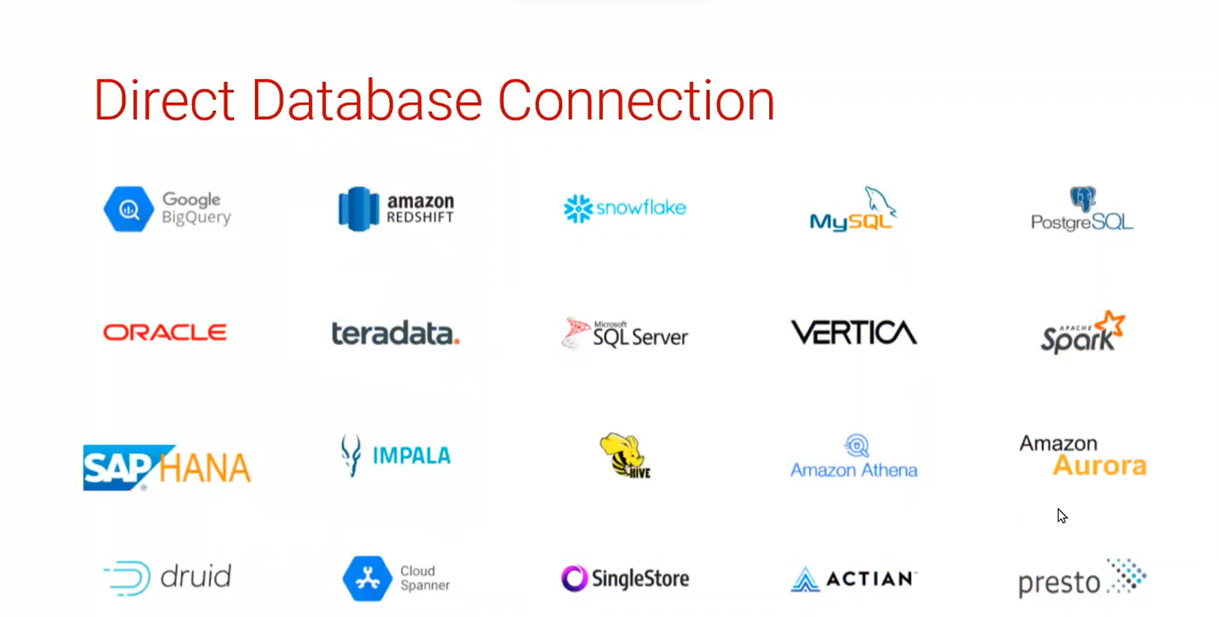

Slide 14

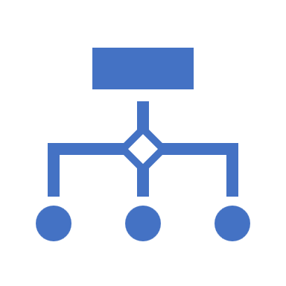
Types Of Modes:
Looker data model exists in two states: Production Mode and Development Mode.
Production Mode:
Production Mode is the production version of Looker. Everyone using a Looker instance in Production Mode accesses their projects in the same state. Project files are read-only in this mode.
Use Production Mode when you are exploring data in Looker for your own analyses or to create saved content (Looks and dashboards) for other users.
Development Mode:
Development Mode lets you make changes to LookML files and to preview how they will affect content on your instance. The changes you make to LookML files in Development Mode do not affect the production environment, until they are pushed to the production environment. (If you are familiar with Git, Development Mode uses a separate branch.)
In Development Mode, you can see the effects of your changes to project files in the Explore area of Looker. Once you're happy with your changes, you can save and merge them into production, where they then will be viewable by everyone.
Development Mode is frequently referred to as dev mode.

Slide 15
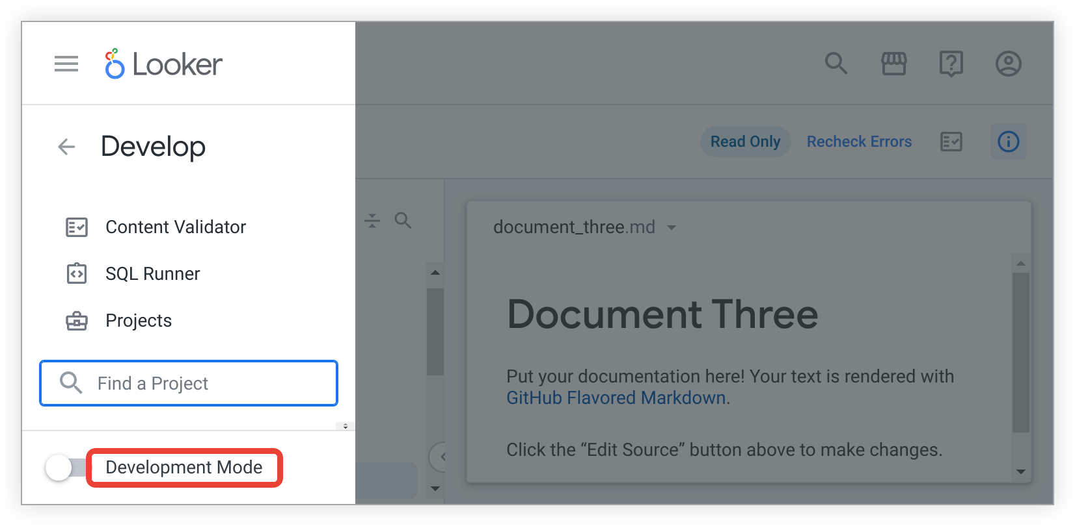
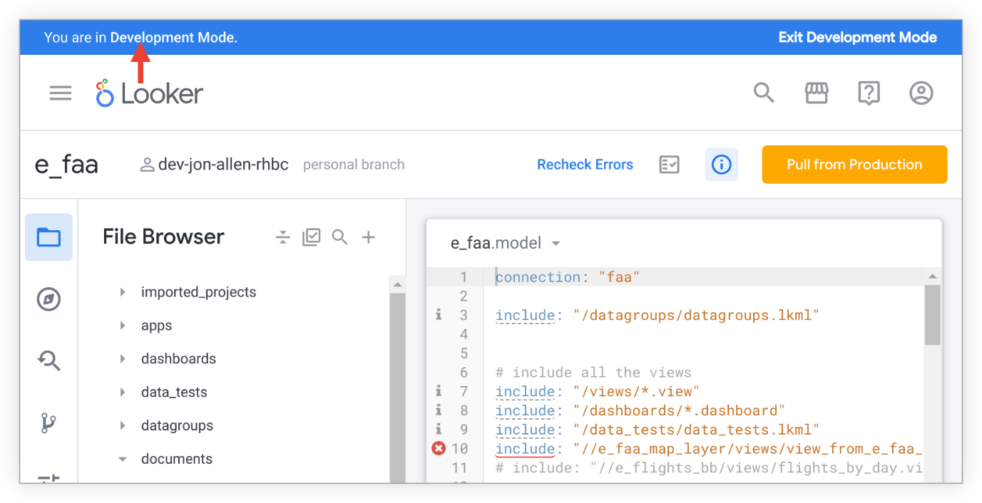

Slide 16
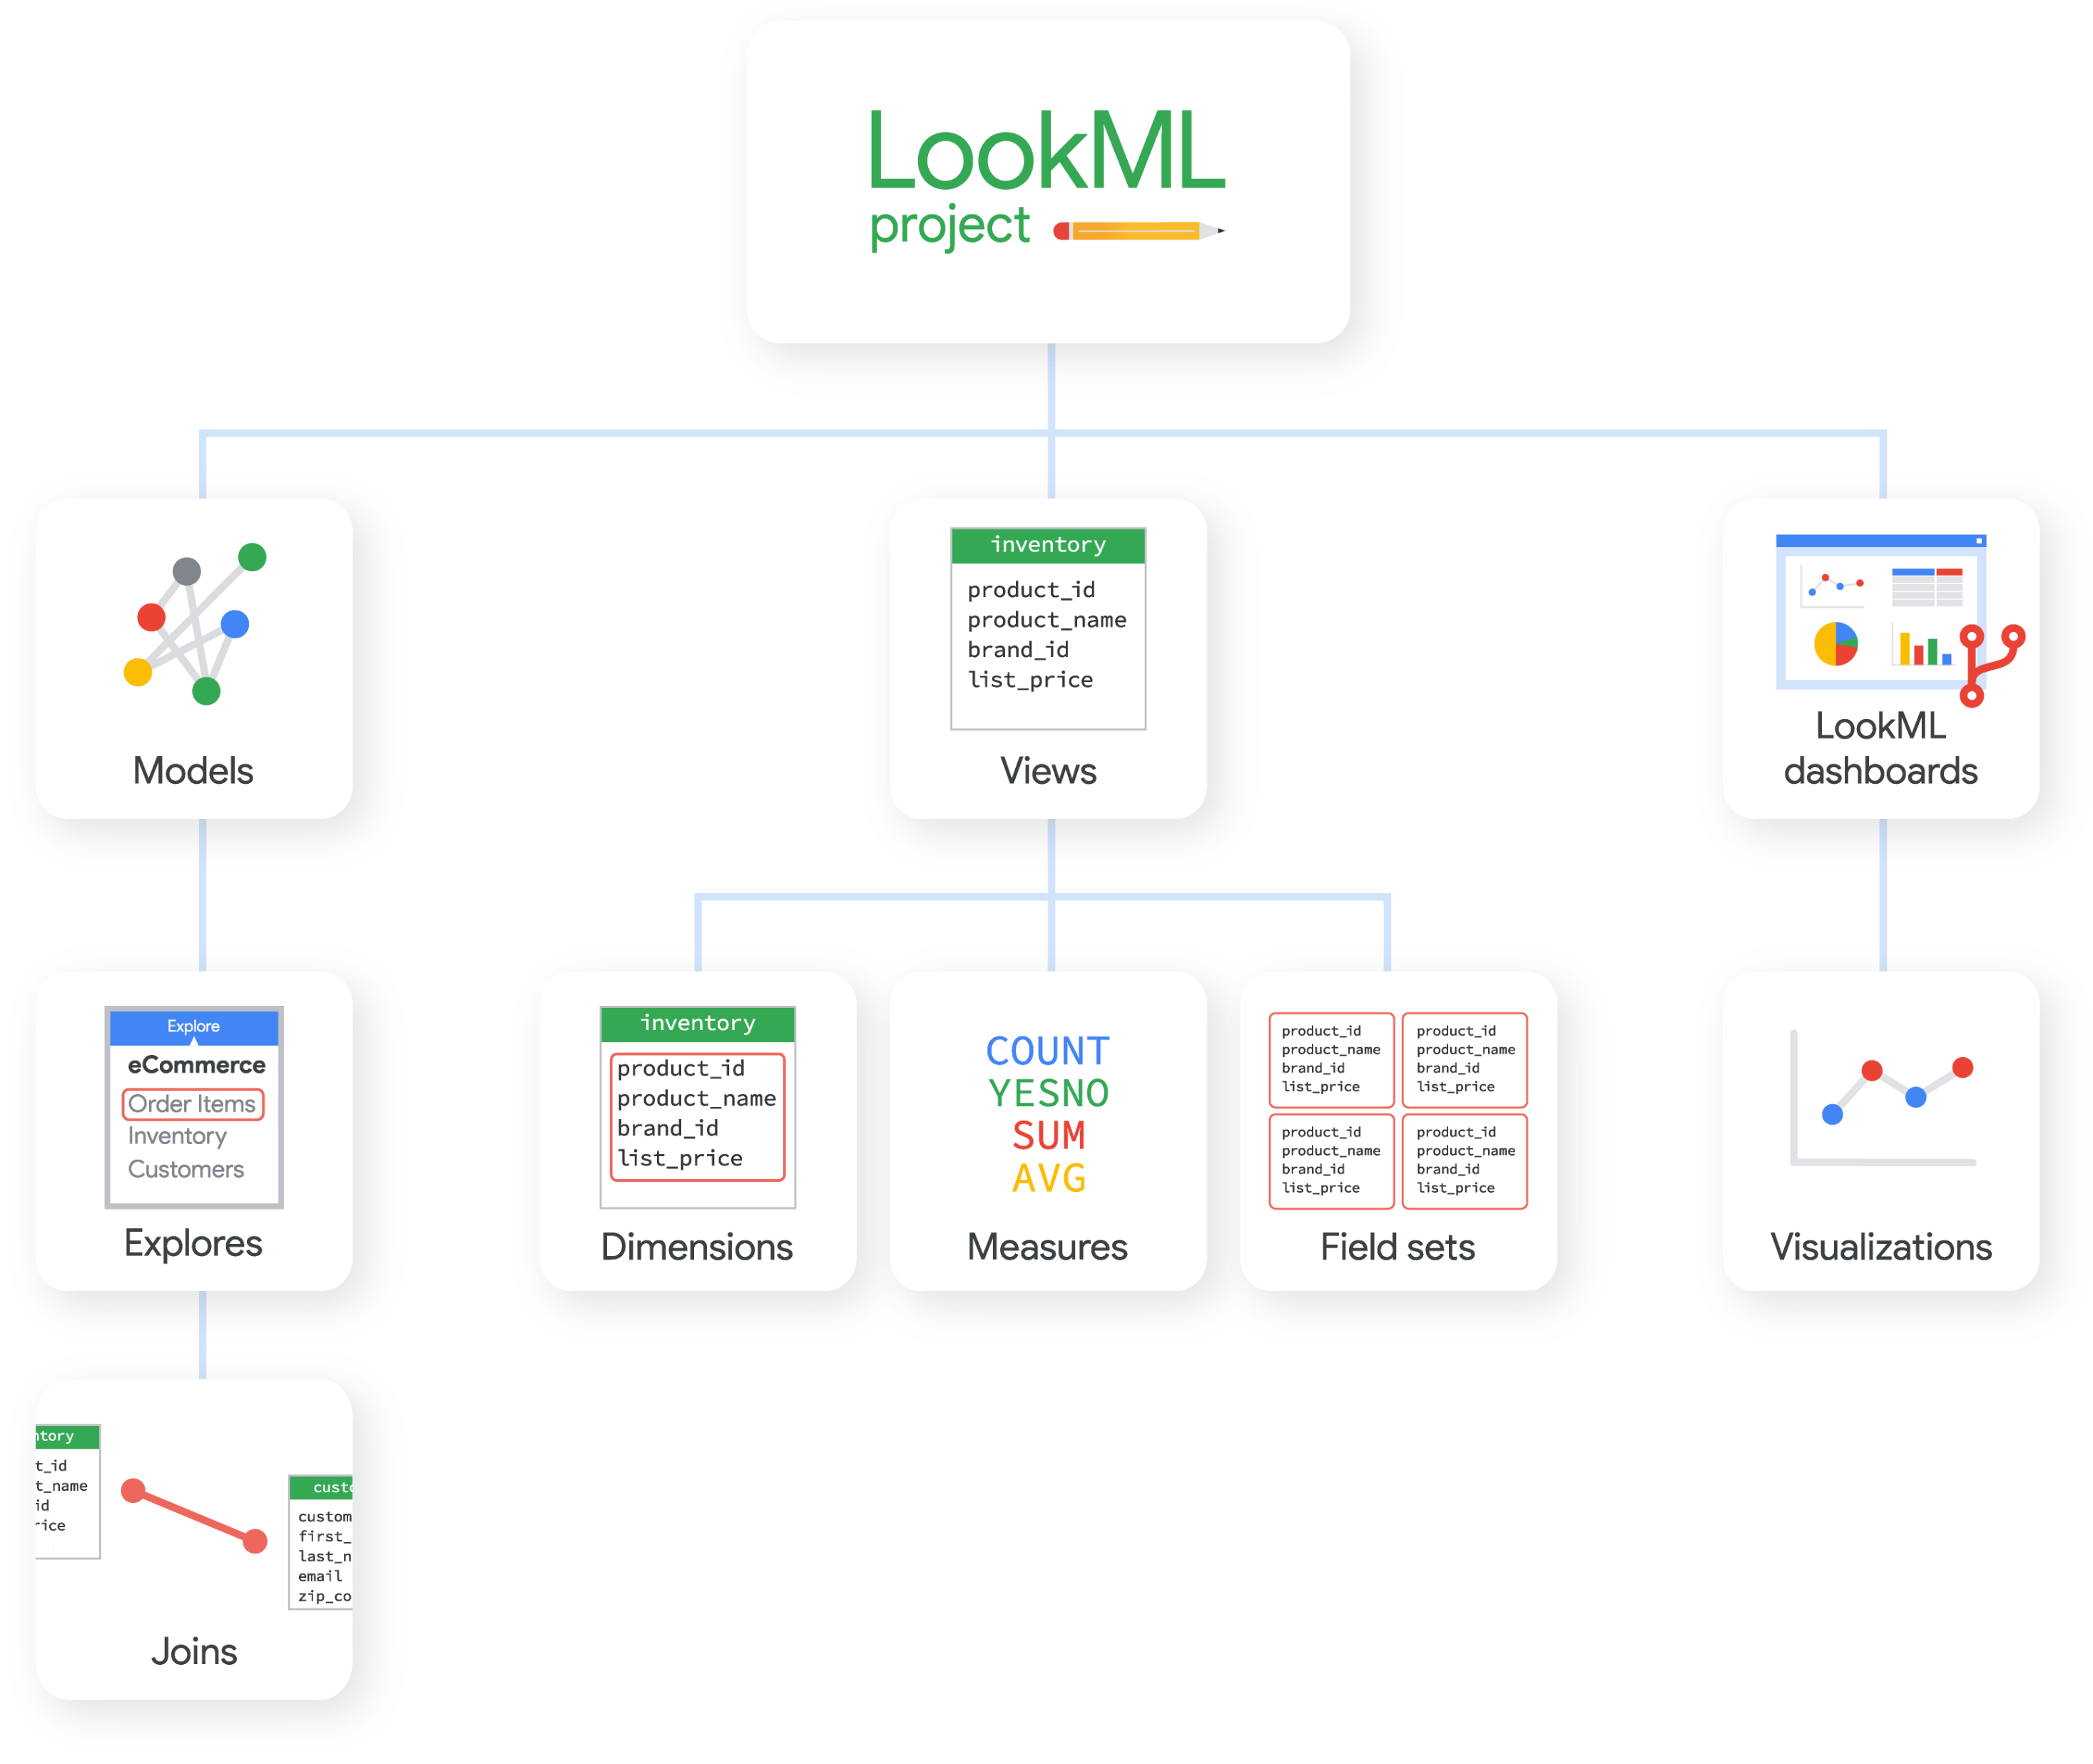

Slide 17
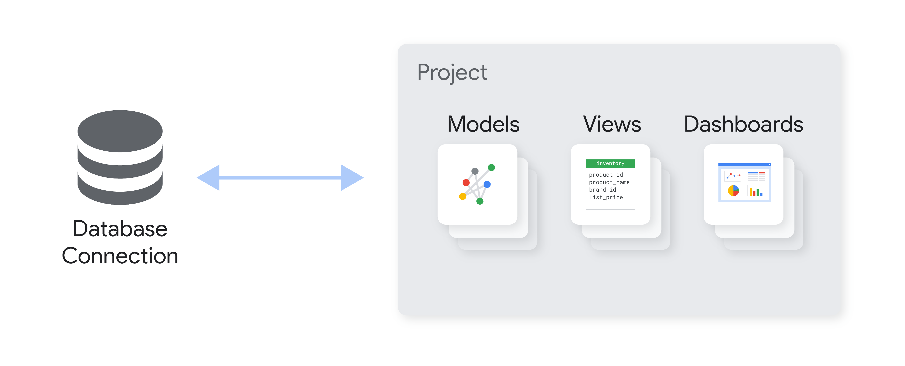

Slide 18
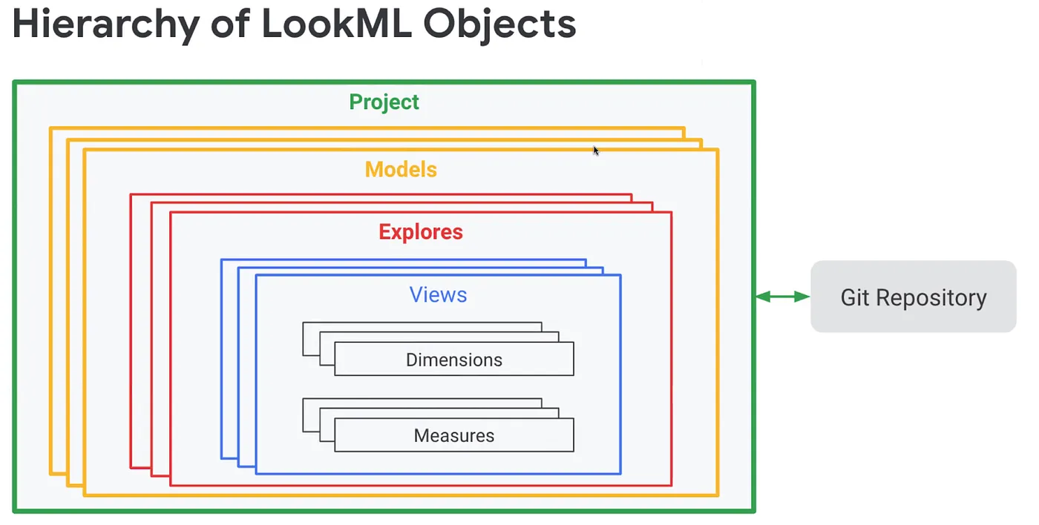

Slide 19
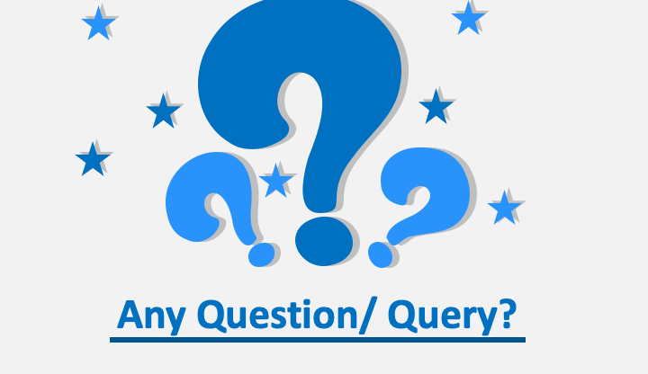

Slide 20


